Slide 1
Improving the Quantification of GHG Emissions and Flows of Reactive Nitrogen (IDEAg-NG)
Alexander Gocht, Sandra Marquardt, Sebastian Neuenfeldt
Thünen Institute of Farm Economics

Slide 2
Task 4 – Development of a methodology to derive farm management information
Aim:
Improved estimation of agro-environmental indicators in CAPRI based on farm management survey data linked with high-resolution geographical data
Scope:
Task 4a: Extraction of information to improve the estimation of GHG emissions and nutrient flows in CAPRI from FSS and SAPM* 2010
Task 4b: Proposal of a methodology to derive the spatial distribution of farm systems while reducing the aggregation error when requesting SAPM data * Survey on agricultural production methods
Notes:
As output of Task 4b was used for the generation of values for Task 4a, we will first elaborate the process of Task 4b.

Slide 3
Task 4b – Methodology for a high-resolution spatial distribution of farm systems
Scope:
Report findings and limitations from the project “Distribution of Agricultural Farming Systems in Germany“
Elaborate on the possibility of transferring such an approach to the EU-level including
Evaluation of the proposed methodology
Data requirements and constraints

Slide 4
Task 4b – Process
Several rounds (getting “right“ results and/or adding new information)
Code development
Using dummy data
Done at TI
Code implementation
Using real data
Data clearance
Interpretation and representation of results using cleared data
Done at TI
Done at FDZ
Working with results
Checking for compliance with data confidentiality
Done by FDZ

Slide 5
Task 4b – Questions
What is the regional distribution of agricultural holdings?
What is their share in total farm types of a region?
What is their share in total UAA of a region?
Example:
Municipality AGS 5558012 “COESFELD”
Farm type 51 “specialist pig”

Slide 6
Task 4b – Farm types in questions
15 = Spezialisierte Getreide-, Ölsaaten und Eiweißpflanzenbetriebe
16 = Spezialisierte Ackerbaubetriebe allgemeiner Art
2 = Spezialisierte Gartenbaubetriebe
35 = Spezialisierte Weinbaubetriebe (Rebanlagenbetriebe)
36_38 = Spezialisierte Obst- und Zitrusbetriebe und Dauerkulturgemischtbetriebe
45 = Spezialisierte Milchviehbetriebe
46 = Spezialisierte Rinderaufzucht- und –mastbetriebe
47 = Rindviehbetriebe: Milcherzeugung, Aufzucht und Mast kombiniert
48 = Futterbaubetriebe (Weideviehbetriebe): Schafe, Ziegen u. a.
51 = Spezialisierte Schweinebetriebe
52_53 = Spezialisierte Geflügelbetriebe und Veredlungsbetriebe mit verschiedenen Verbunderzeugnissen
6 = Pflanzenbauverbundbetriebe
7 = Viehhaltungsverbundbetriebe
83 = Ackerbau – Futterbau- (Weidevieh-)-Verbundbetriebe
84 = Verbundbetriebe mit verschiedenen Kombinationen Pflanzenbau–Viehhaltung

Slide 7
Task 4b – STEP 1 – Defining the farm typology
Objective: Establish typology of individual farms based on a consistent framework (SO values)
Input data: FSS information of 1999,2003,2007,2010
BUT
1999-2007 – use of EF nomenclature
2010 – use of C0 nomenclature
Notes:
Add technical info
DefiningTheTypology.R and ti_FDZ_functions_1.R (runs with real and fake data samples)
Input data
FSS data from the FDZ
SO coefficients

Slide 8
Task 4b – STEP 1 – Defining the farm typology
Establishment of consistent nomenclature (all C0 codes)
Mapping of German C0 codes to EU FSS nomenclature (e.g. B_1_1_1)
Mapping of SO coefficients to FSS nomenclature
Calculation of SO values for 1999-2010
Assignment of „type of farming“ based on general, principal and particular types of farming using SO values
Notes:
Describtion of codes:
C0-codes – Metadatenreport Landwirtschaftszählung 2010 (www.forschungsdatenzentrum.de/bestand/landwirtschaftszaehlung_haupterhebung/fdz_landwirtschaftszaehlung_2010_metadaten.pdf)
FSS nomenclature EC regulation 1242/2008 (http://eur-lex.europa.eu/legal-content/EN/ALL/?uri=CELEX:32008R1242)

Slide 9
Task 4b – STEP 1 – Defining the farm typology
Output
UAA
Not real values
Regional identifier
Typology of farm types in AGS “COESFELD”
AGS | nr | C0008U1 | C0240 | […] | GeT | PrT | PaT
5558012 | 25262 | 2010 | 115 |  | 5 | 51 | 5120
5558012 | 34513 | 2010 | 1 |  | 4 | 46 | 4600
5558012 | 2347 | 1999 | 107 |  | 5 | 52 | 5230
5558012 | 13818 | 1999 | 5 |  | 4 | 47 | 4700
Holding ID
Notes:
Nr – number of holding
C0240 – UAA

Slide 10
Task 4b – STEP 2 – Calculation of farm type shares
Share of farm‘s UAA in total UAA of region
Share of number of farms of a certain type in total number of farms of region
Share of farm types in AGS “COESFELD”
AGS | nr | C0008U1 | C0240 | type | share | variable
5558012 | 25262 | 2010 | 115 | 51 | 0.54 | holdings
5558012 | 34513 | 2010 | 1 | 46 | 0.46 | holdings
5558012 | 25262 | 2010 | 115 | 51 | 0.74 | UAA
5558012 | 34513 | 2010 | 1 | 46 | 0.26 | UAA
Not real values
Data confidentiality restrictions!
Notes:
Add technical info
Zusätzliche Spalten: Anzahl Betrieb von Typ XX; Anzahl alle Betriebe (je Region und Jahr)

Slide 11
Task 4b – STEP 3 – Cluster analysis
Objective: Map similar communities into 20 clusters (clusters are defined over all years)
Similar➔ in the sense of defining characteristics
Share of farm‘s UAA in total UAA of region
Share of number of farms of a certain type in total number of farms of region
Cluster communities using manhattan distances (per farm type !)
Using UAA
Using number of holdings
Notes:
Calculate share of farm type in a region minimizing the manhattan distances for the farm type in question ➔ get different values depending on which farm type is targeted for the minimization.
Additional technical info
Test-runs-for_cluster_and_figures.R (include: loop_for_cluster_and_figures.R) => actual cluster analysis and generation of pictures
Input data
Fake: NA2760_Panel990307_LZ2010_shares_FAKE_DATENSATZ.rdata
Real: NA2760_Panel990307_LZ2010_Speicher_Debugging_C0.rdata
Output data
Clustereigenschaften.txt (reduced version of ClustereigenschaftenGesamt.txt)
ClustereigenschaftenGesamt.txt
Anzahl_Betriebe_Durchlauf_Clusteranalyse…txt
Mapping_cluster
Mean_BWA…jpg
Drawmaps_from_cluster_results.R =>reads in real data to generate maps (data after confidentiality clearance)
Input data
Mapping_cluster….txt
ClustereigenschaftenGesamt….txt
Data sent by FDZ: Anzahl_Betriebe_Durchlauf…txt; Mapping_cluster…txt; ClustereigenschaftenGesamt…txt

Slide 12
Task 4b – STEP 3 – Cluster analysis
Number of communities in cluster
STEP 3 – Cluster analysis
Output:
Farm type-Cluster-Share Relationship (for farm type 51)
cluster | type | frequency | mean | variable
15 | 51 | 555 | 0.54 | holding
16 | 51 | 174 | 0.74 | UAA
Farm type-Cluster-Region Relationship (for farm type 51)
AGS | year | cluster | variable
5558012 | 2010 | 15 | holding
5558012 | 2010 | 16 | UAA
Based on Coesfeld belonging to cluster 15 (variable “holdings”), it can be concluded that 54% of agricultural holdings in Coesfeld are farms of the farm type 51.
Notes:
Frequency = number of communities in cluster

Slide 13
Task 4b – Summary
Typology of farm types in AGS “COESFELD”
AGS | nr | C0008U1 | C0240 | […] | GeT | PrT | PaT
5558012 | 25262 | 2010 | 115 |  | 5 | 51 | 5120
5558012 | 34513 | 2010 | 1 |  | 4 | 46 | 4600
[…]
STEP 1
Not real values
Share of farm types in AGS “COESFELD”
AGS | nr | C0008U1 | C0240 | type | share | variable
5558012 | 25262 | 2010 | 115 | 51 | 0.54 | holdings
5558012 | 34513 | 2010 | 1 | 46 | 0.46 | holdings
5558012 | 25262 | 2010 | 115 | 51 | 0.74 | UAA
5558012 | 34513 | 2010 | 1 | 46 | 0.26 | UAA
STEP 2
Not real values
Data confidentiality restrictions!
Farm type-Cluster-Share Relationship (for farm type 51)
cluster | type | frequency | mean | variable
15 | 51 | 555 | 0.54 | holding
16 | 51 | 174 | 0.74 | UAA
Farm type-Cluster-Region Relationship (for farm type 51)
AGS | year | cluster | variable
5558012 | 2010 | 15 | holding
5558012 | 2010 | 16 | UAA
STEP3
54% of holdings in Coesfeld are farms of the farm type 51.
Notes:
Based on Coesfeld belonging to cluster 15 (variable holdings), it can be concluded that 54% of agricultural holdings in Coesfeld are farms of the farm type 51.

Slide 14
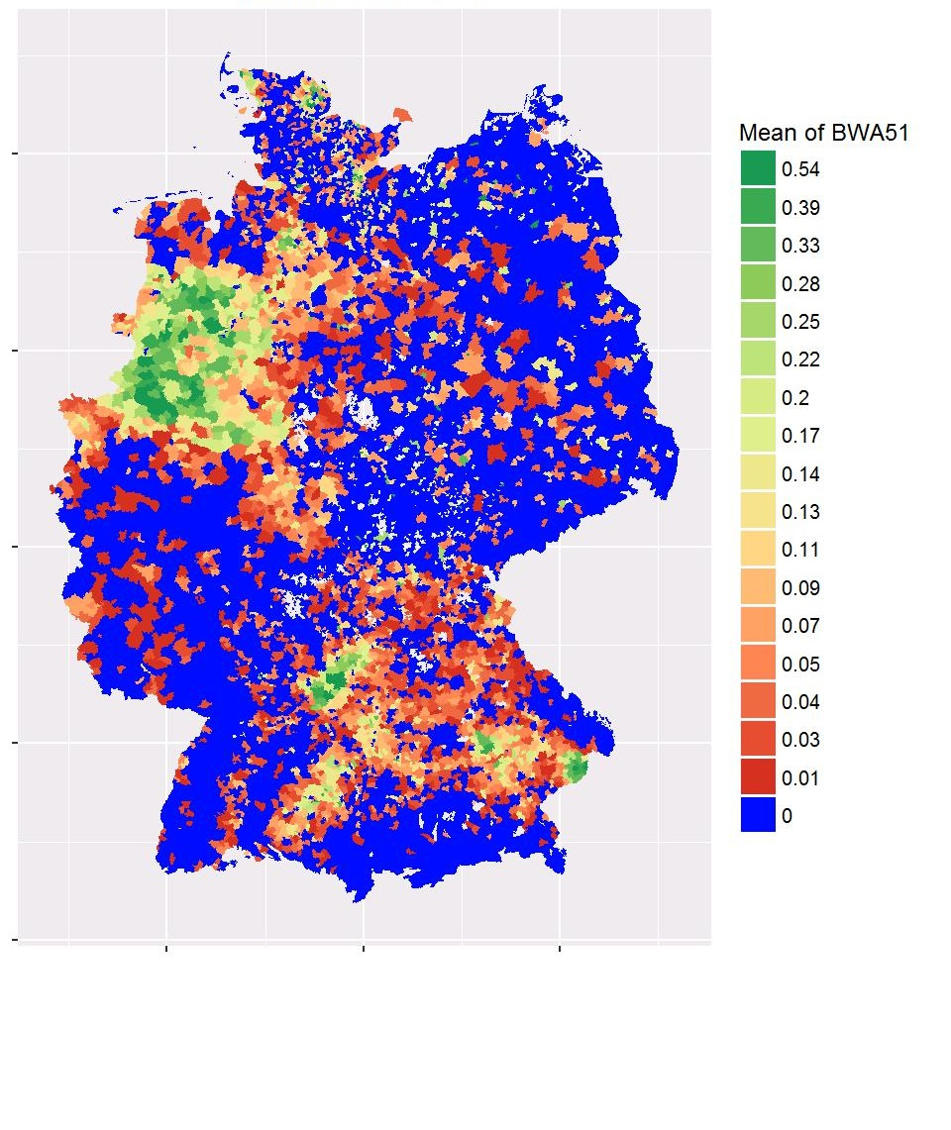
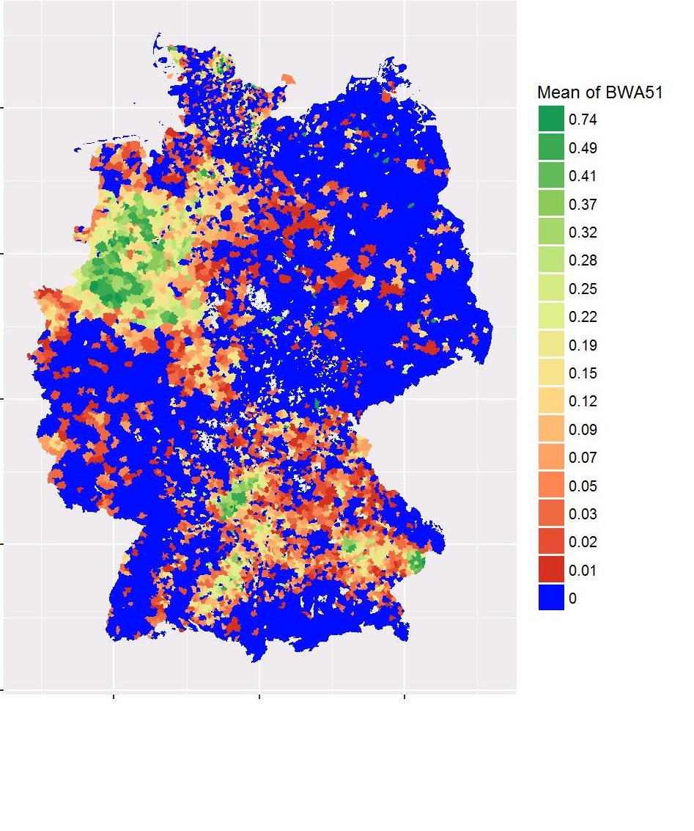
Task 4b – Final output for COESFELD
Mean share of holdings allocated to farm type 51 of total holdings per region in 2010
Mean share of UAA allocated to farm type 51 of total UAA per region in 2010
COE
COE
Note: grey areas – As the cluster analysis is conducted over all years in the data set (1999, 2003, 2007, 2010), cases may arise in which a region does not have a value for the current farm type for one of these years (e.g. due to re-classification of the farm type, abandonment of farming activity etc.).

Slide 15
Task 4b – Data confidentiality – General rules
Primary suppression
Too few observations in a defined selection (e.g. 3 farms)
Dominant cases
Secondary suppression
Cases where a value falling under primary suppression restrictions can be deduced based on subtraction
Notes:
Dominant cases – e.g. if in a group of 20 farms the share of farm X is so high that it would be able to deduce this farm based on the results and knowledge of the region.

Slide 16
Task 4b – Data confidentiality – Applicability to cluster analysis
Primary suppression
One cluster must include at least 20 communities
Means of >0 must have SD>0
➔if not, mean in all communities in cluster would be identical ➔deducing individual communities possible
Secondary suppression
Would be necessary if mean=1 and SD=0
➔All holdings in cluster would belong to same farm type
➔➔Solution: merge affected clusters
Notes:
Merge clusters with „next similar“ clusters => i.e. based on cluster characteristics (share UAA, share holdings)

Slide 17
Task 4b – Advantages and limitations
Advantages:
Results become public domain (available for many other projects, Agraratlas.de)
Validation with uncensored data possible
Possibility of allocating further indicators that are highly correlated with the specialization, e.g.:
Manure management
GHG related management practices (grazing vs housing)
Tillage management (SoC)
Limitations:
Time consuming – feedback loops due to data confidentiality
Software – different R versions used

Slide 18
Task 4b – Possibilities of transferring the approach to the EU level
Data
Agricultural census at EU level
SO coefficients for the particular years
Understanding the data confidentiality requirements
Defining the high resolution regional unit (municipality, grid, ..)
Software & Access
Adjustment of code for Germany to EU data
Nomenclature
Consistent regional unit
Application of routine requires either access to
non-anonymus data (secure-use files) in Eurostat's "Safe centre” in Luxembourg
or sending of pre-coded routines to EUROSTAT

Slide 19
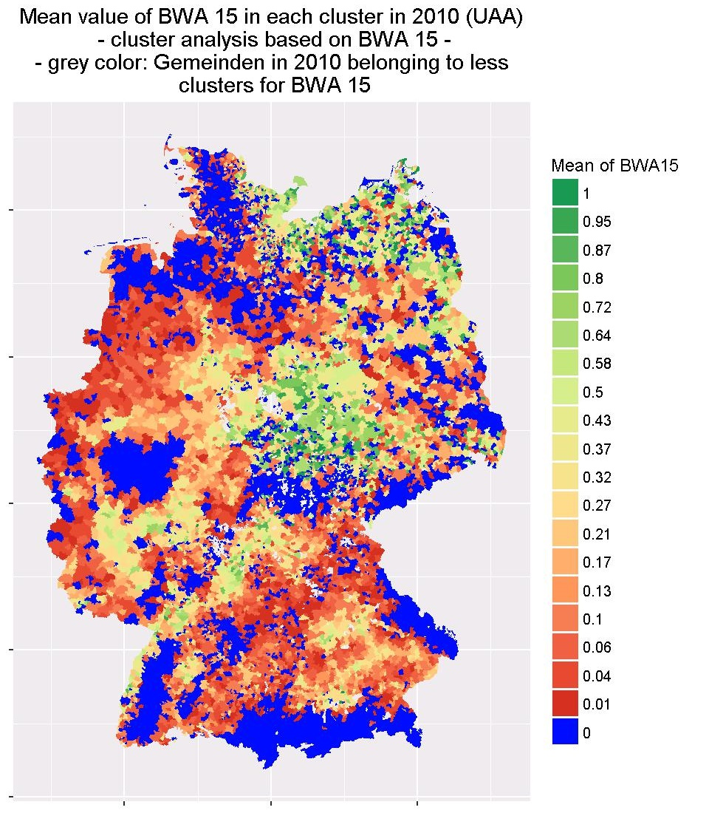
Task 4b – Output for other farm types

Slide 20
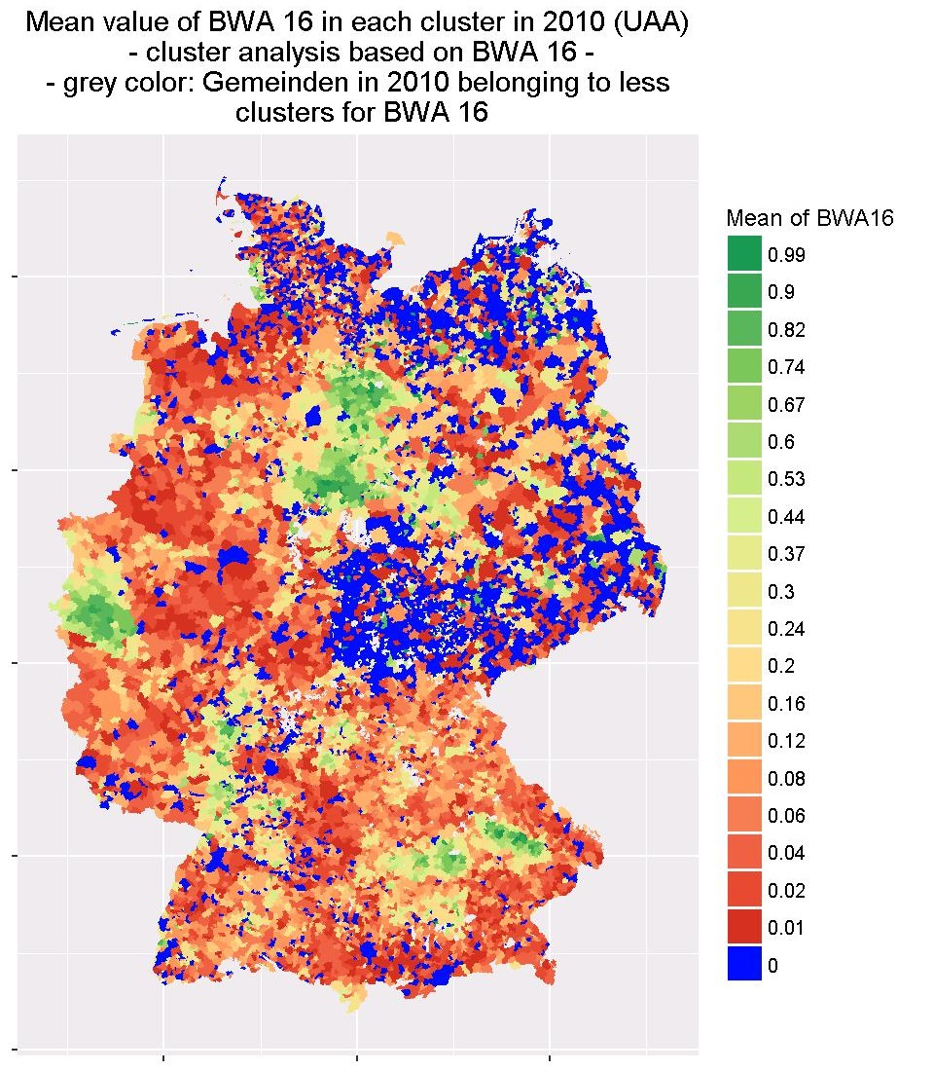
Task 4b – Output for other farm types

Slide 21
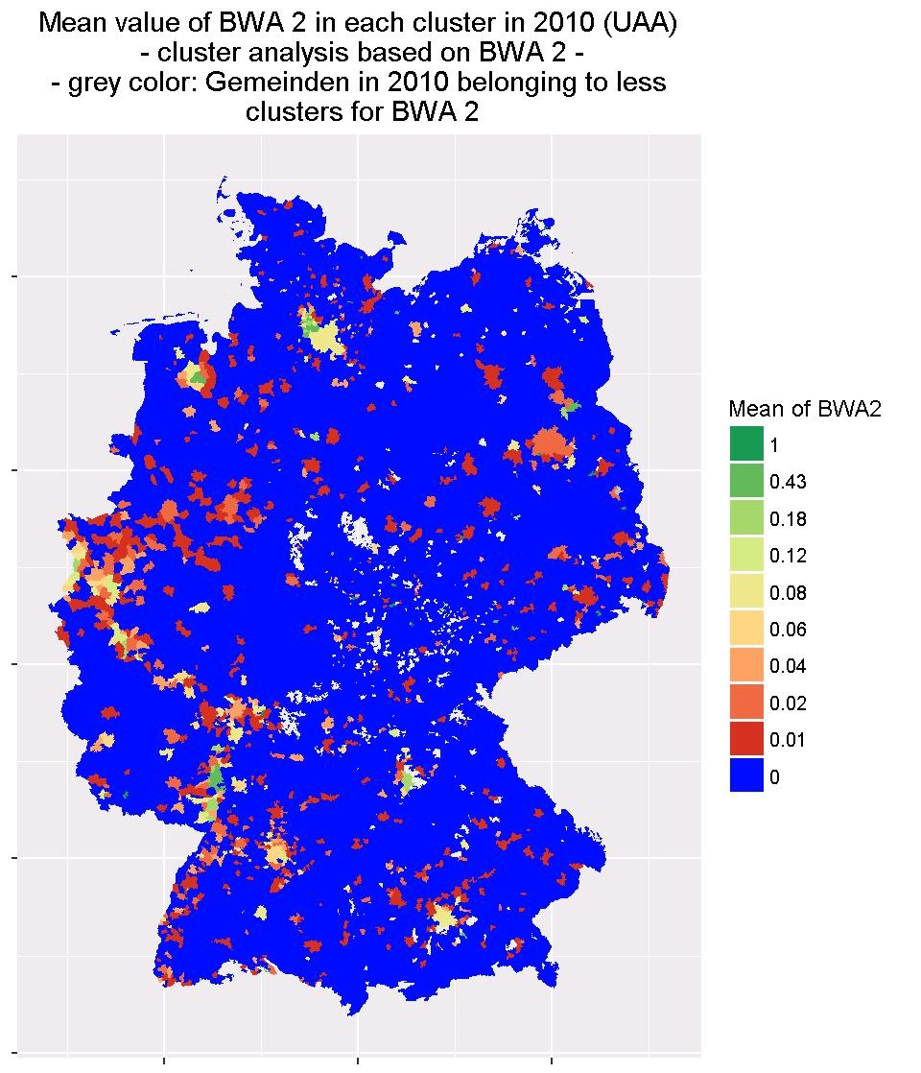
Task 4b – Output for other farm types

Slide 22
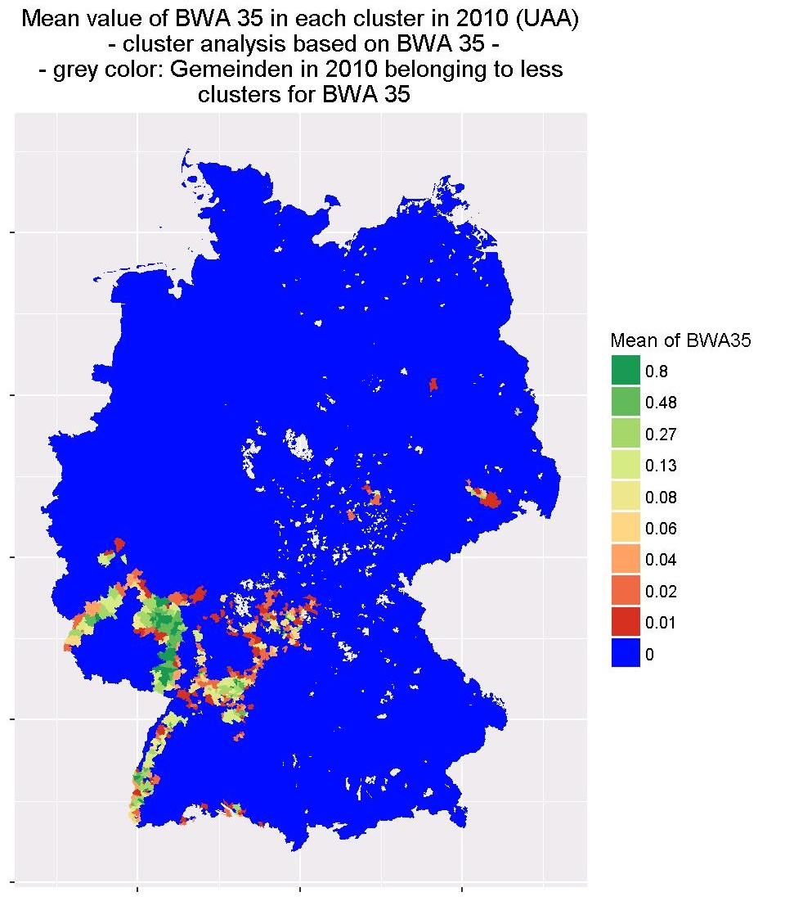
Task 4b – Output for other farm types

Slide 23
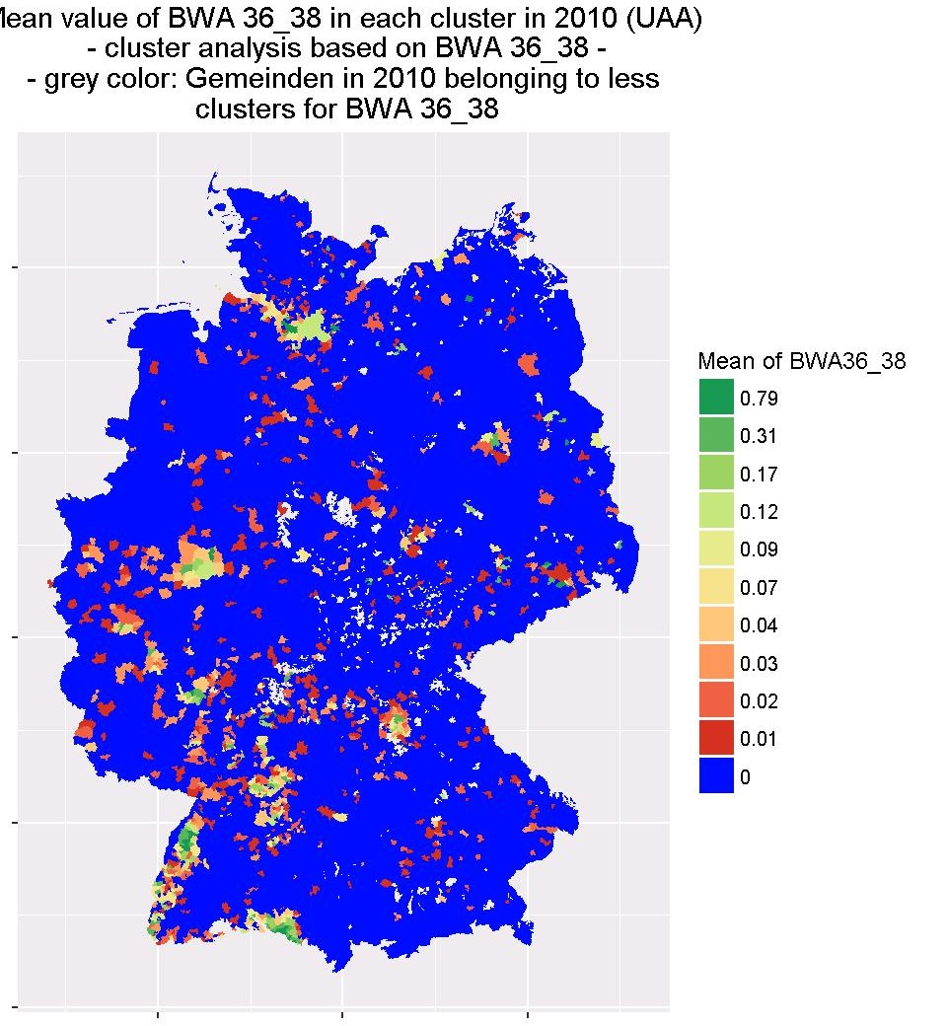
Task 4b – Output for other farm types

Slide 24
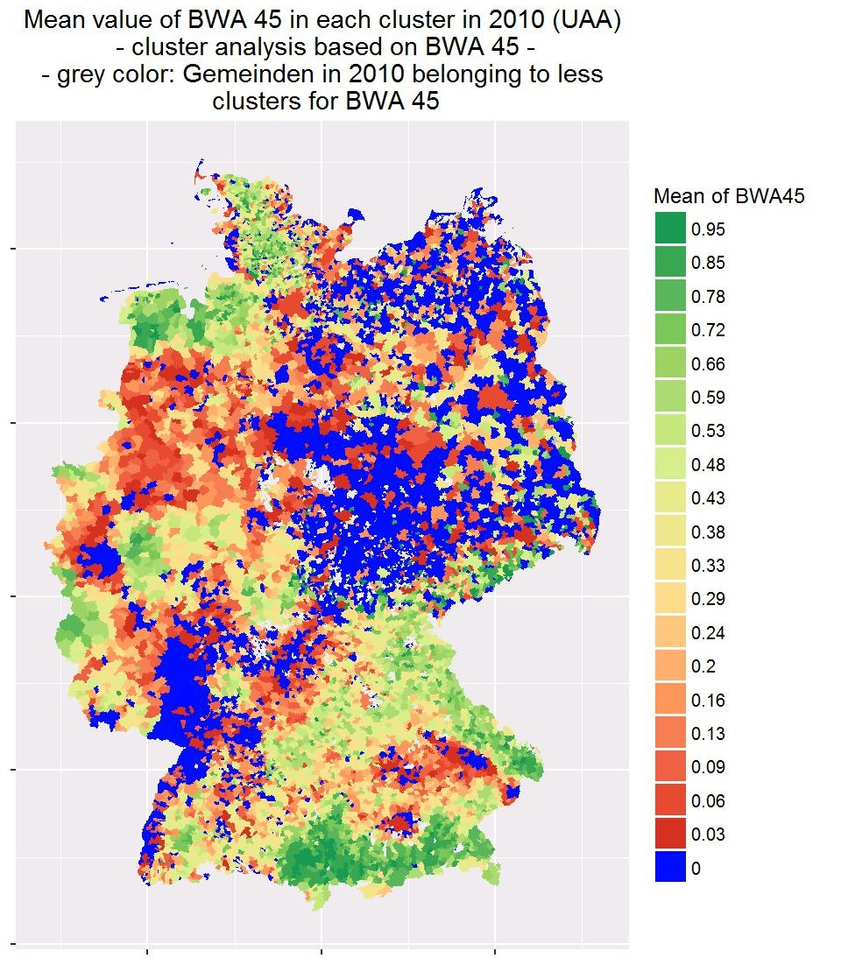
Task 4b – Output for other farm types

Slide 25
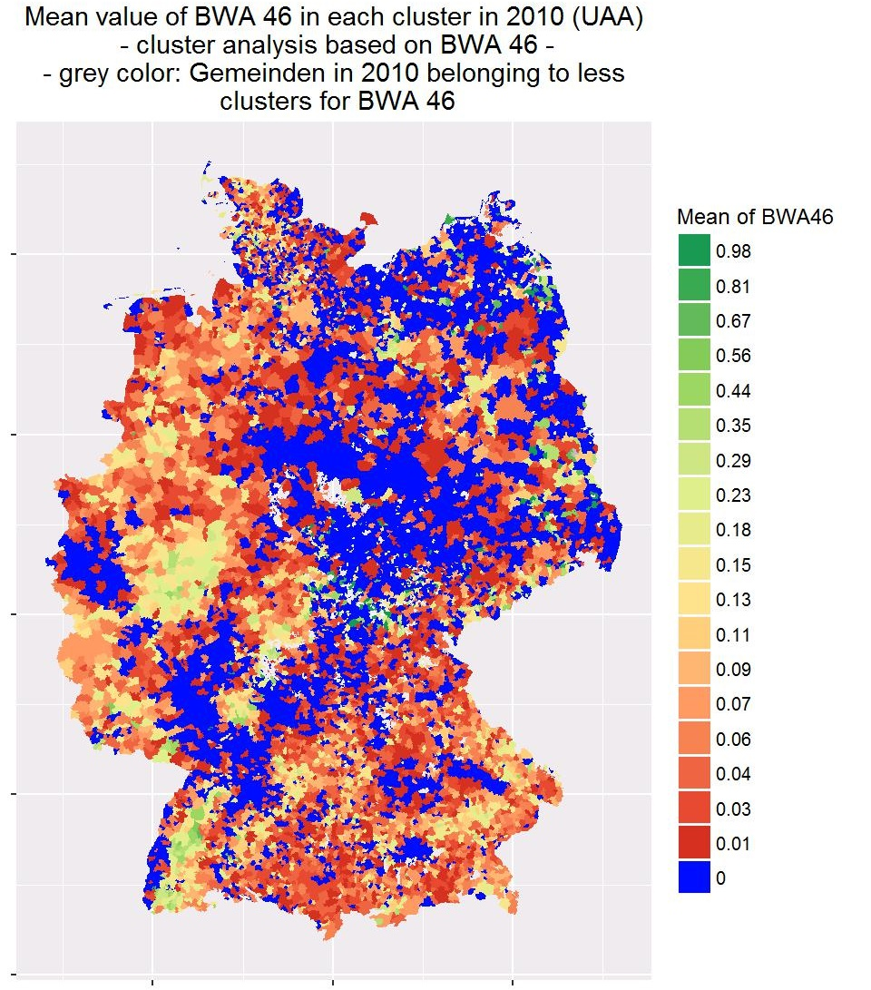
Task 4b – Output for other farm types

Slide 26
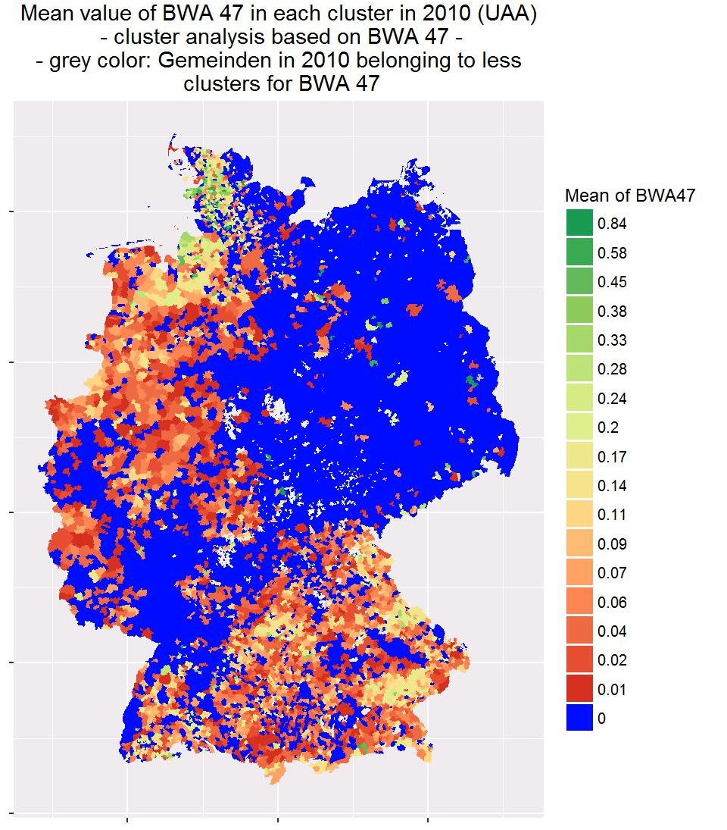
Task 4b – Output for other farm types

Slide 27
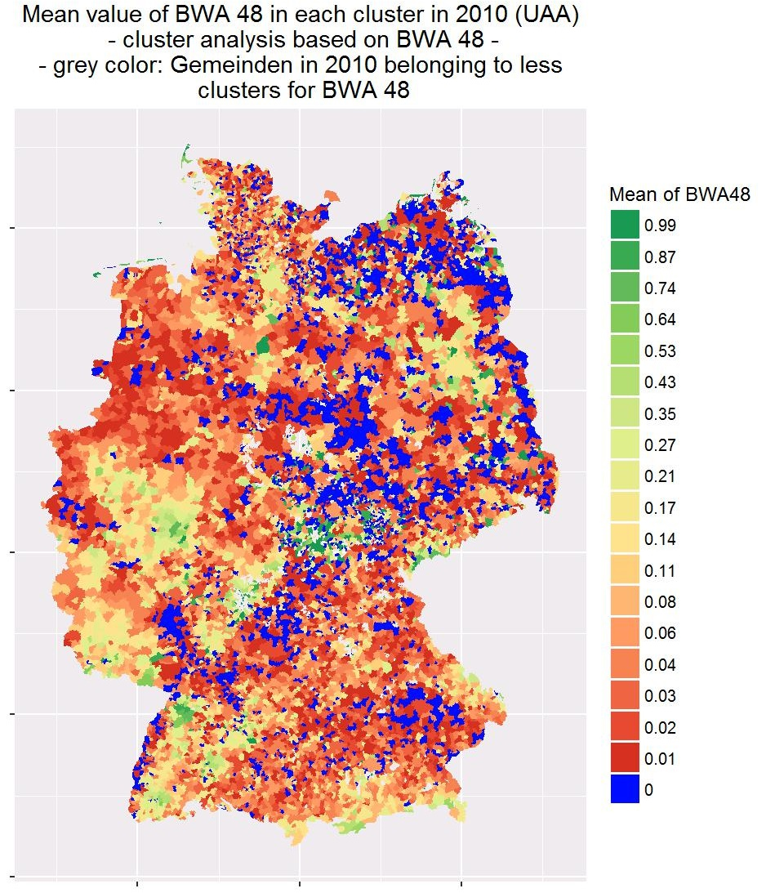
Task 4b – Output for other farm types

Slide 28
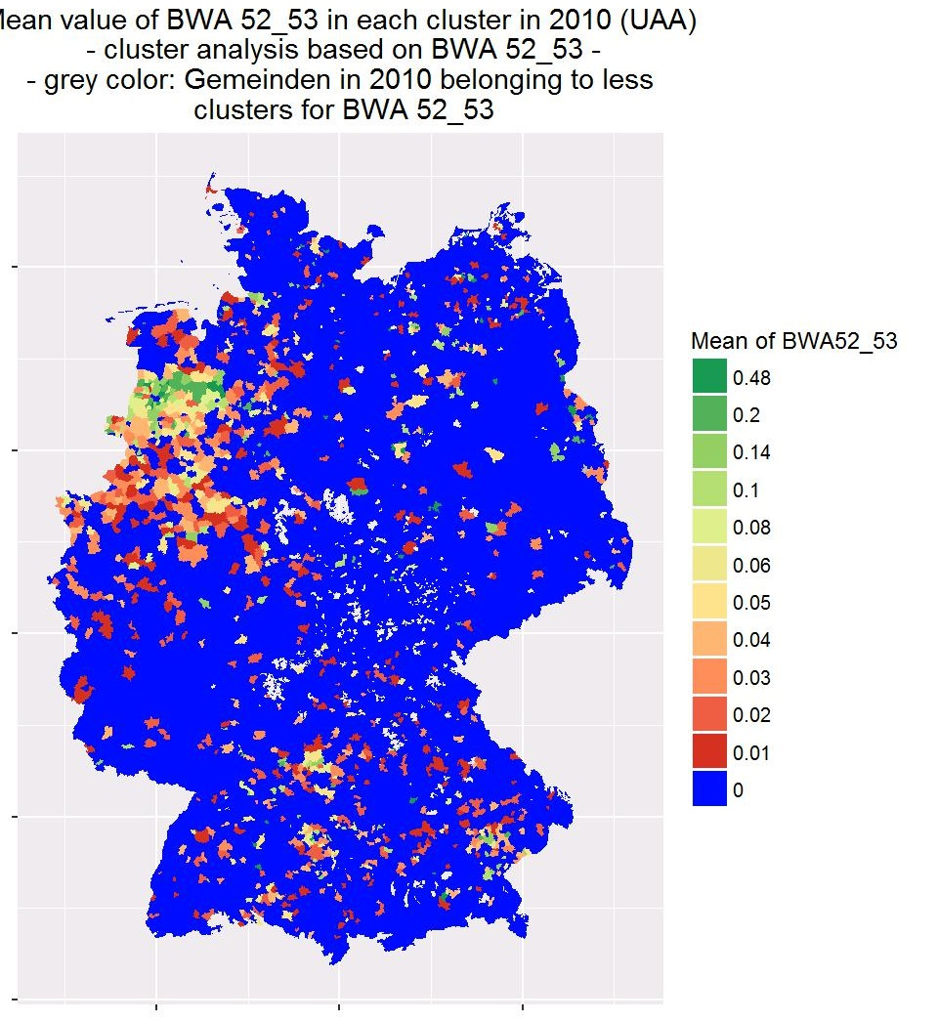
Task 4b – Output for other farm types

Slide 29
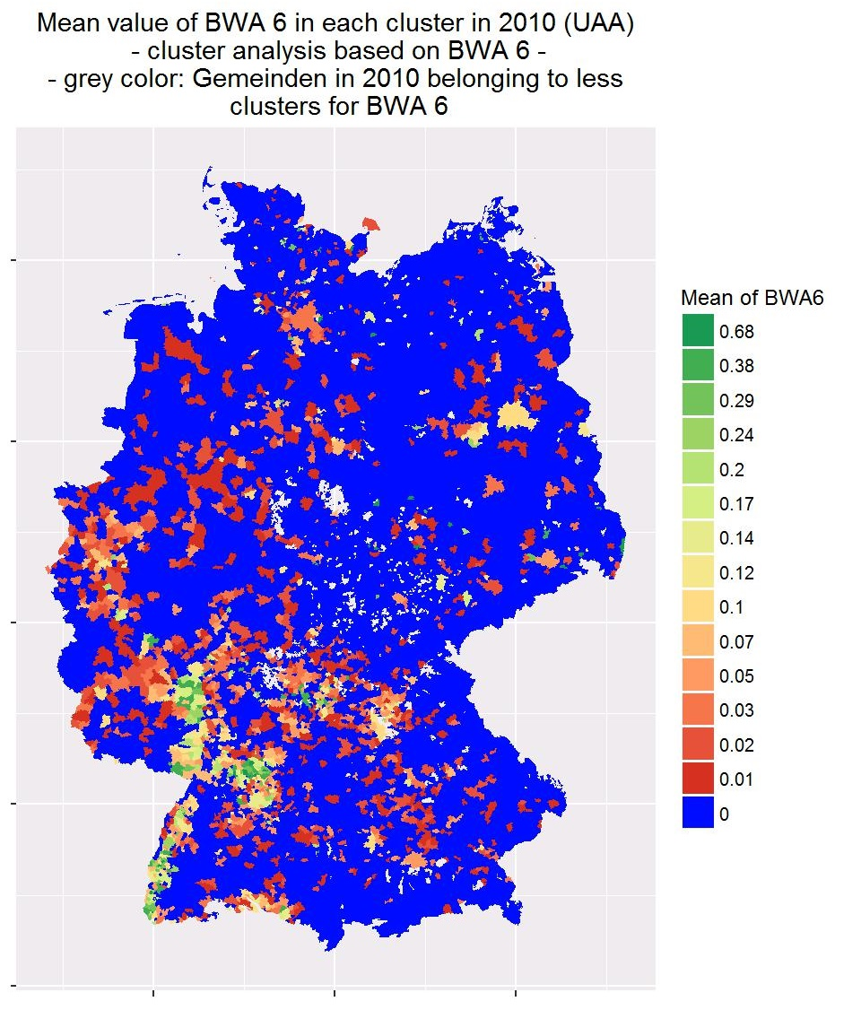
Task 4b – Output for other farm types

Slide 30
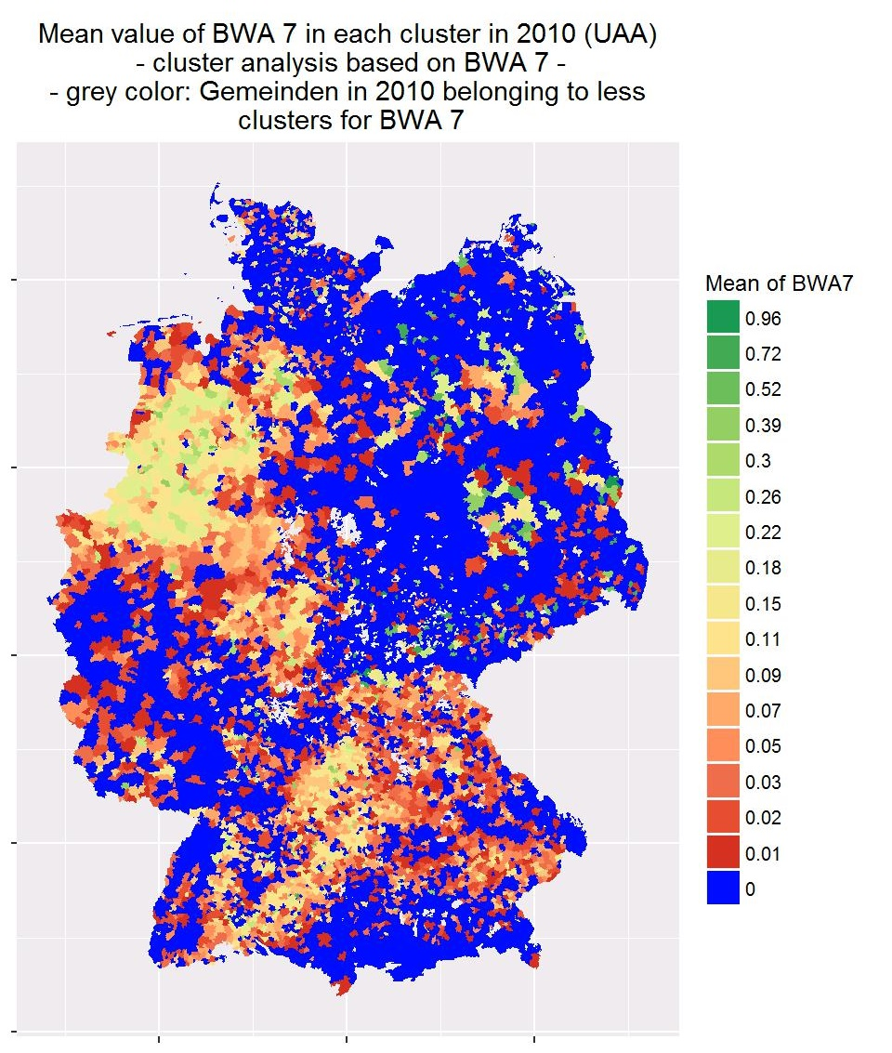
Task 4b – Output for other farm types

Slide 31
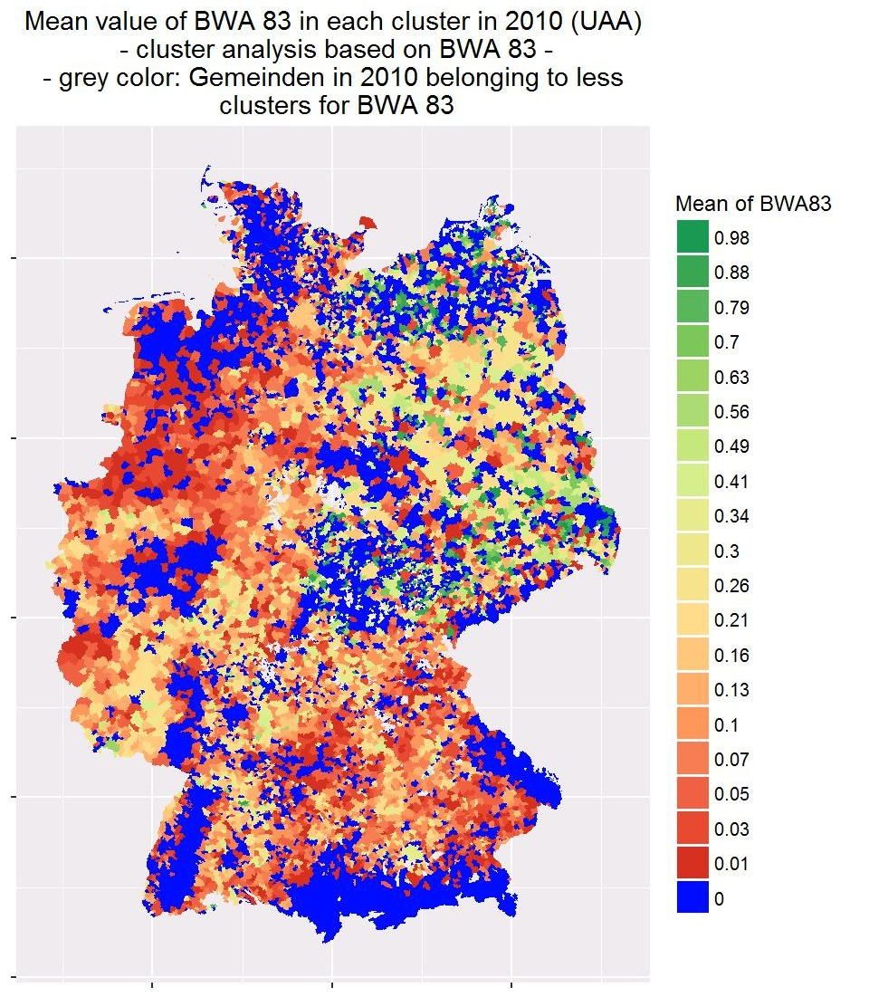
Task 4b – Output for other farm types

Slide 32
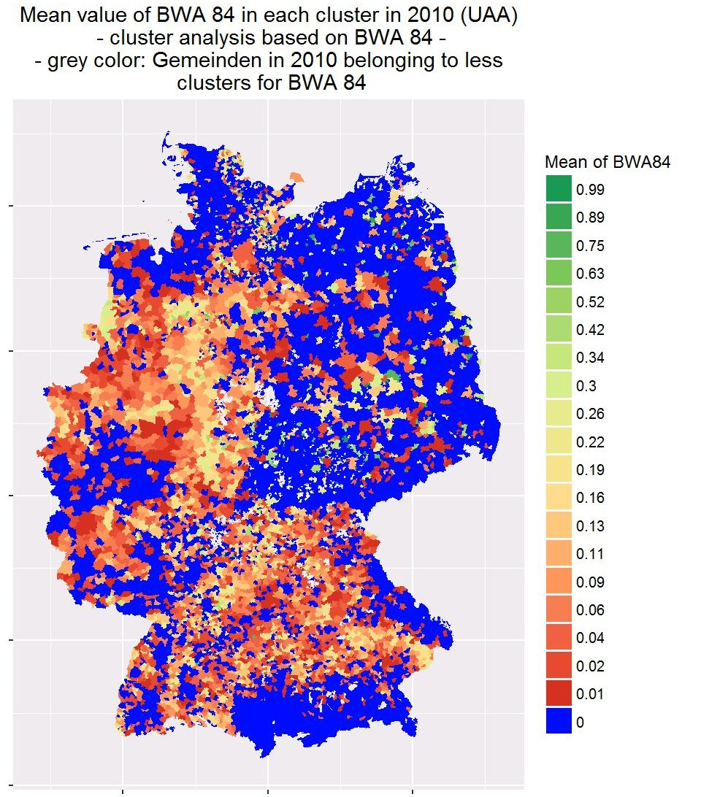
Task 4b – Output for other farm types

